Slide 1
Whillans Ice Sheet Velocity
5/3/2026
Kaitlyn Sanchez, Kadidia Mariko, Emilia Orta

Slide 2
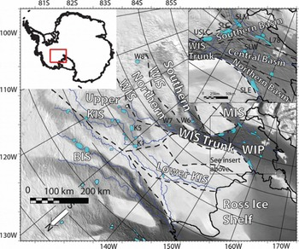
Introduction
Whillans Ice Plain is a tidally-paced stick-slip ice stream in West Antarctica
Ice sheet is either grounded or floating
Movement comes from stick-slip events (12 or 24 hours)
Each slip event displaces the ice about 0.5m
As it moves from grounded to floating, it is contributing to sea-level rise
There are indicators that the ice stream may be slowing over time, which affects the mass balance of the ice sheet
[Carter et al. 2017]
Notes:
So stick-slip events happen either every 12 or 24 hours based on the tidal conditions
Ice stream shut down = reorganization of how ice flows

Slide 3
Research Questions
How does the ice sheet velocity vary across Whillans Ice Plain on a decadal time scale?
How is the temporal variation in ice sheet velocity correlated to the amount of 12 versus 24-hour slip events that occur?
Notes:
Aka how do features like the grounding line or subglacial hydrology effect the flow

Slide 4
Dataset & Challenges
Dataset:
Global Navigation Satellite System (GNSS) position data from GPS stations across Whillans Ice Plain
Data spanning 2008-2019 and was pulled from the Zendo listed in Katz et al., 2026
Stick-Slip Event Catalog from Katz et al., 2026
Input to our workflow: Precise Point Positioning (PPP) files
.pos files are text files that have calculated geographic positions (like lat and lon) from the GPS/GNSS stations over time
Challenges:
Initially tried to use ITS_LIVE but there was a gap in coverage at this location during the time of interest
The PPPs had 15 second epochs which made for noisy velocity calculations
Not all of the stations recorded for the entirety
Notes:
Over time for this is 15-second epochs (one position estimate every 15 seconds)
**This is where Emilias new image should go

Slide 5
Overall Methods
Parse_one_pos
Reads single GPS file and pulls out the forward/backward pass measurements
Converts coordinates from degree-minute-seconds into decimal degrees
Compute_station_velocity
Takes all position files for one station and builds a daily velocity time series
Projects lat/lon into polar stereographic meters
Turns 15-second epochs into daily median positions
Require 1,000 valid epochs per day
Computes day-to-day displacement
30-day rolling median to produce a smooth background velocity
Build_ppp_timeseries
Loops over all 48 stations
Computes station velocity (using previous function)
Concatenates the results into a combined time series CSV
Assign_velocities_to_slips
For each slip event take the median daily velocity of past 30 days
Need at least 5 valid daily estimates
Outputs a table where every slip event gets a pre-event velocity from each station

Slide 6
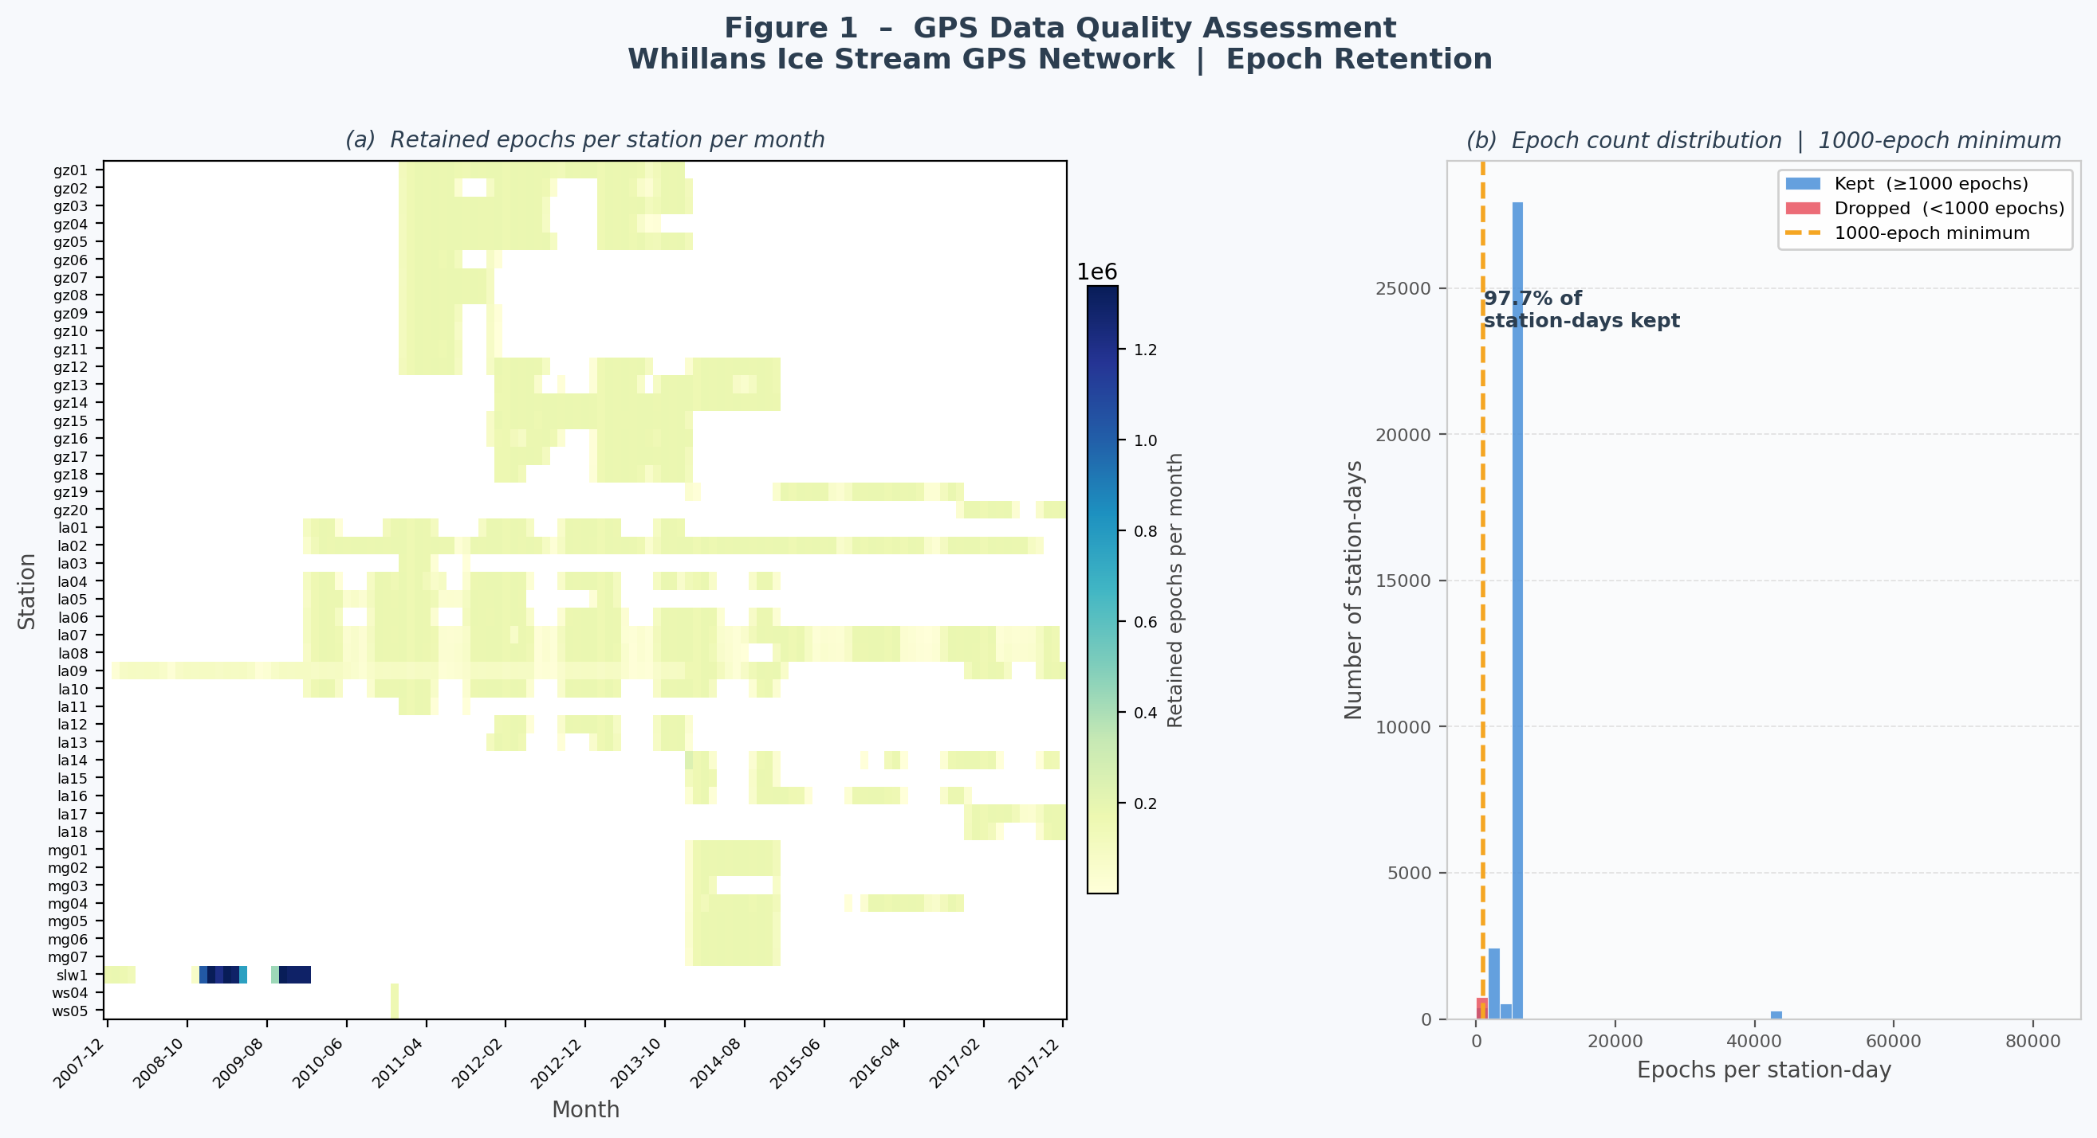

Slide 7
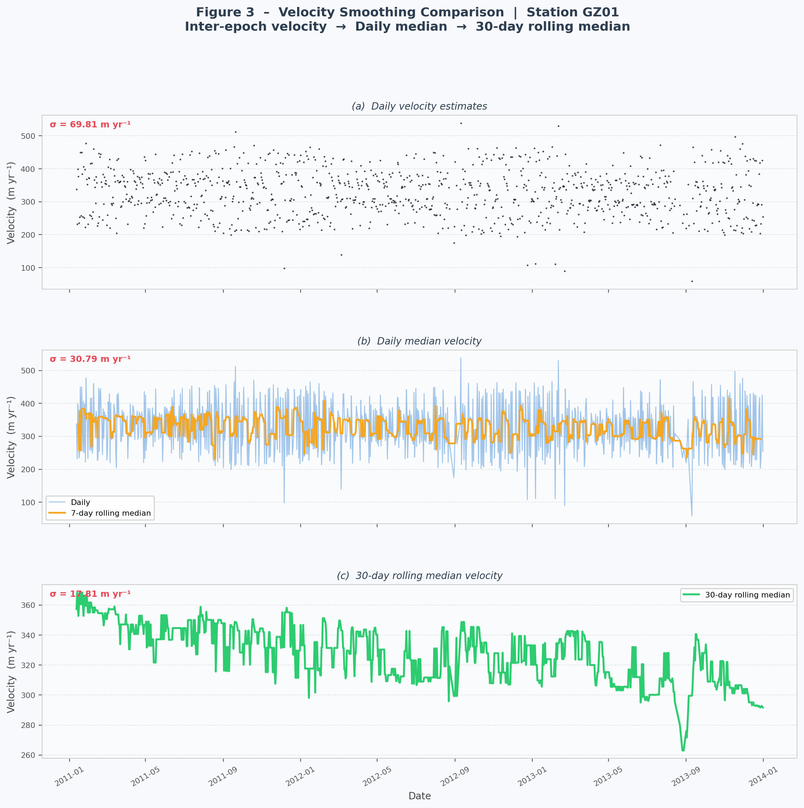
STD in m/yr
Panel A’s STD of ~70 makes it difficult to see long-term velocity changes
Daily median cuts the STD in half roughly, and the rolling median cuts it almost in half again
Median was chosen over mean because it’s more robust to outliers
Notes:
Rolling median vs regular median:
Regular median = one value for the whole data set
Rolling median = 30 day window so it better retains how the velocity is changing day to day

Slide 8
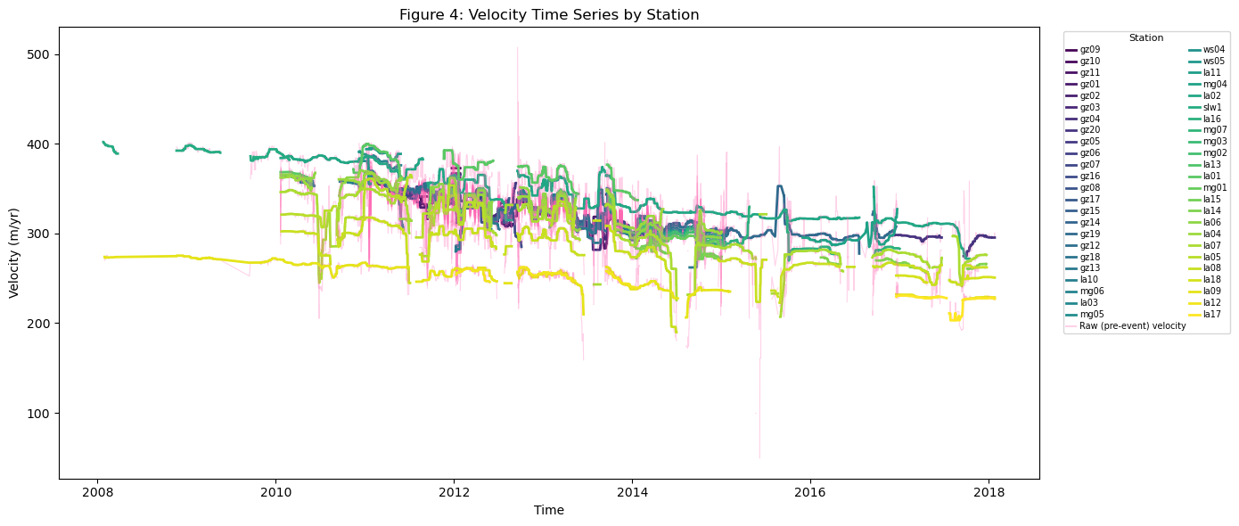
Notes:
The pre velocity before stick-slip events is represented in pink and is noisy
However, the 30-day smoothed velocity for each station shows the consistent deceleration trend and that while there are difference in velocity based on location, the ice plain as whole is coupled in the sense that it responds to forcings (such as tides) as a unit even if each component responds with slightly different magnitudes

Slide 9
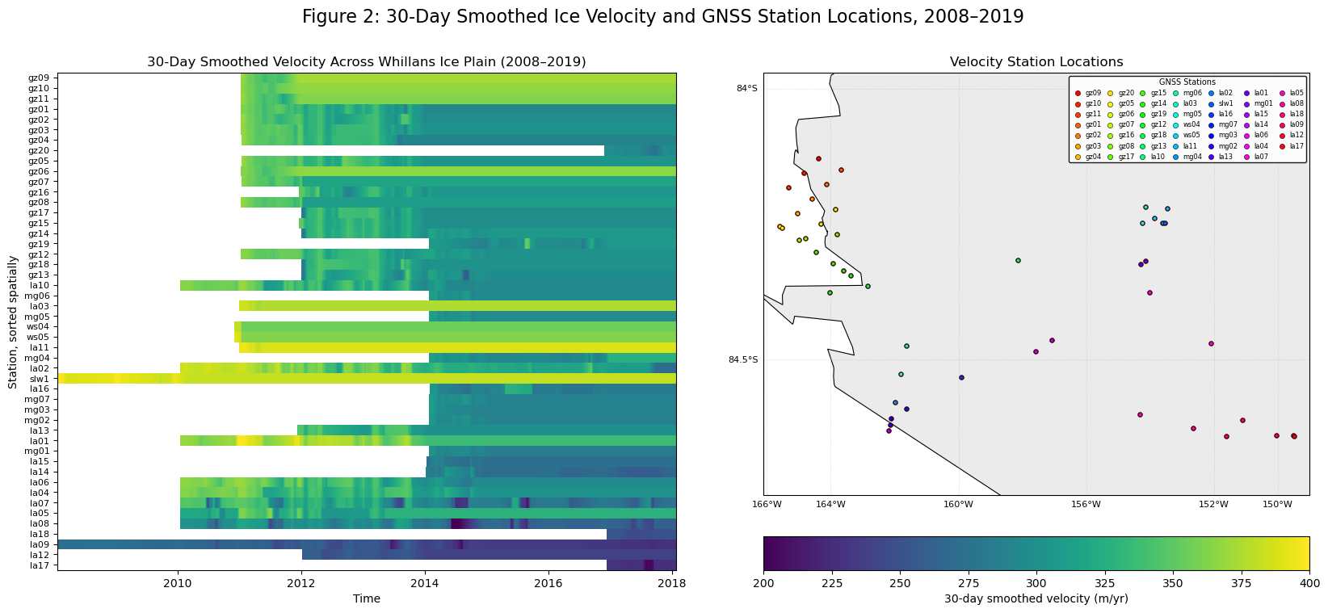
Notes:
Shows that different parts of the ice plain are moving at different rates
Notably the stations along the grounding zone have the fastest velocity and the grounded parts of the ice plain moving the slowest

Slide 10
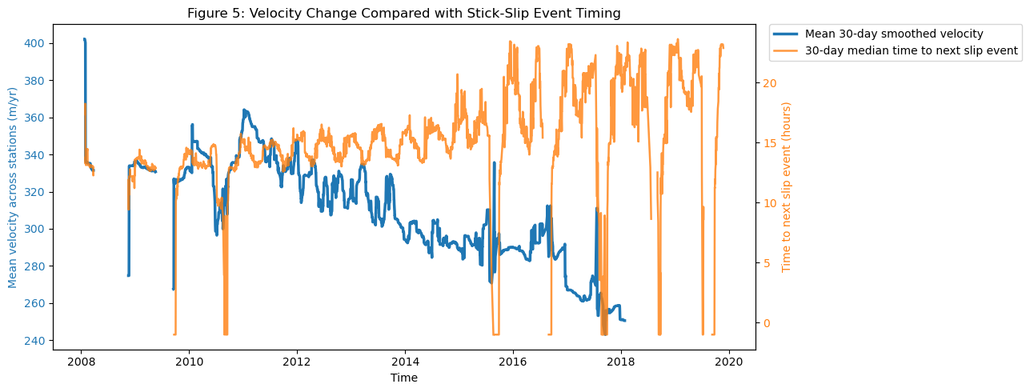
Notes:
Highlighting the inversely proportional relationship between the velocity and the stick slip events
Over the course of the dataset the velocity decreases which is leading to longer inter-event times (aka having less secondary/12-hour regime slips)

Slide 11
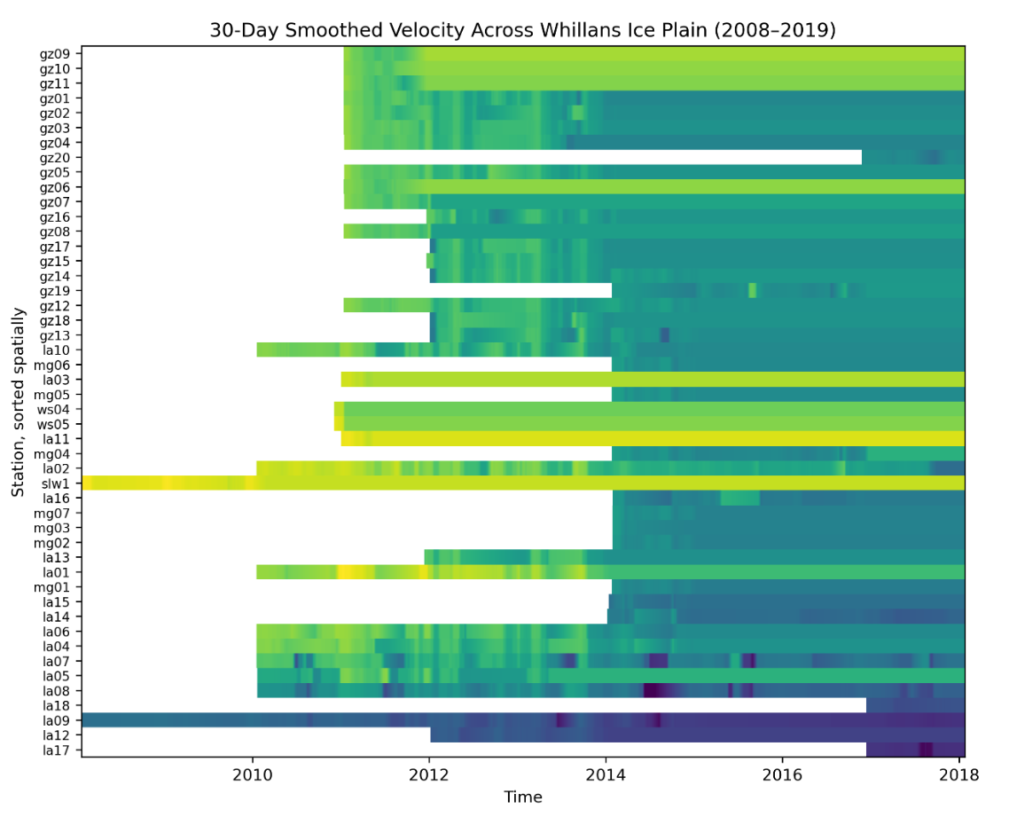
Limitations
Uneven station coverage across the time frame:
The gz-stations were only active between 2011-2014
30-day smoothing window may mask some shorter velocity changes that may have meaningful signal
There are gaps present in the data set from the velocity cleaning
Pre-slip-event velocity is only assigned if there are more than 5 daily estimates are present in the 30-day window before each event
Notes:
Velocity cleaning of days with less than 1,000 15 second epochs.
Kadida

Slide 12
Findings & Significance
Spatial and Temporal Velocity Change:
Velocity ranges from ~200-400 m/yr based on features
Grounding zone
Grounded ice
Floating ice
The whole ice plain experiences deceleration overtime
Velocity and Slip-Timing Relationship:
Mean velocity and time-to-next-slip are inversely related
Higher velocity corresponds to shorter time between events
Longer event intervals are becoming more common towards the event of the decade because of the deceleration
Notes:
Inverse relationship makes sense because faster ice flow likely builds stress more quickly

Slide 13


Future Work & Acknowledgements
Future Work:
What is driving the deceleration trend, for example, looking into subglacial hydrology
Exploring whether pre-event velocity is a statistically significant predictor of slip event characteristics (such as size, duration, or time between events)
Use velocity as a feature in machine learning models for predicting time-to-next-slip events
Acknowledgements:
Stick-slip catalog from Zachary Katz and Sam Brown
PPP files pulled from Katz et al. 2026
Dr. Matt Siegfired and Zachary Katz provided intuition for what trends should be seen in the velocity data
Notes:
Emilia

